Slide 1
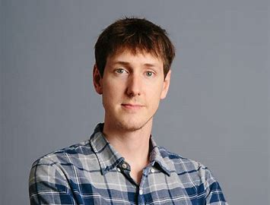
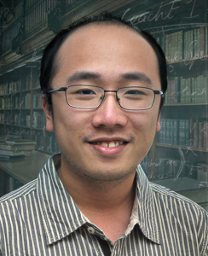
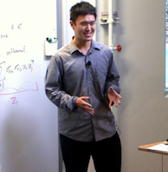
Chasing Convex Bodies
4
Mark Sellke
Partially Based on WORK FROM Microsoft Research With:
1
2
1, 3
4-->5
Sébastien Bubeck, Bo’az Klartag, Yin Tat Lee, Yuanzhi Li
1: MSR Redmond 2: Weizmann Institute 3: University of Washington 4: Stanford 5: CMU

Slide 2
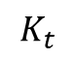
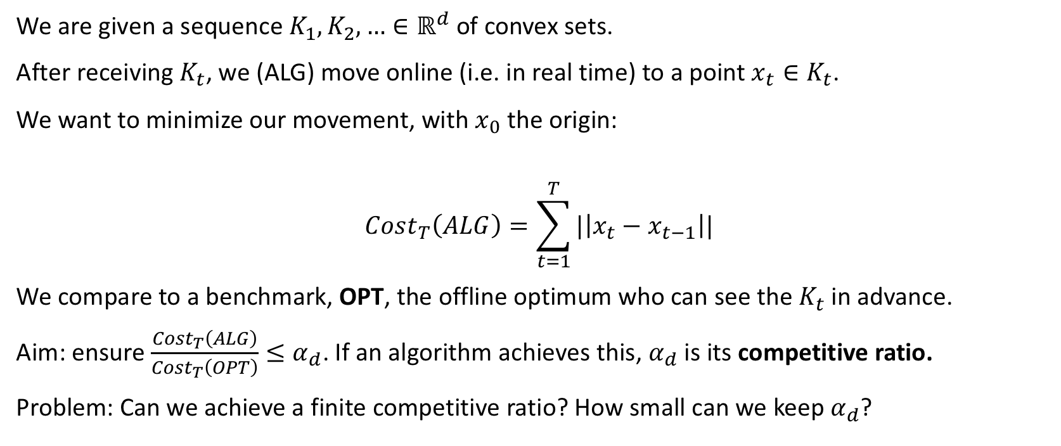
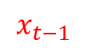
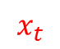
The Chasing Convex Bodies Problem
We are given a sequence $K_{1},K_{2},…∈ℝ^{d}$ of convex sets.
After receiving $K_{t}$, we (ALG) move online (i.e. in real time) to a point $x_{t}∈K_{t}$.
We want to minimize our movement, with $x_{0}$ the origin:
$$Cost_{T}\left(ALG\right)=\sum_{t=1}^{T}{|\left|x_{t}−x_{t−1}\right||}$$
We compare to a benchmark, OPT, the offline optimum who can see the $K_{t}$ in advance.
Aim: ensure $\frac{Cost_{T}\left(ALG\right)}{Cost_{T}\left(OPT\right)}≤α_{d}$. If an algorithm achieves this, $α_{d}$ is its competitive ratio.
Problem: Can we achieve a finite competitive ratio? How small can we keep $α_{d}$?
$$K_{t}$$
$$x_{t−1}$$
$$x_{t}$$

Slide 3
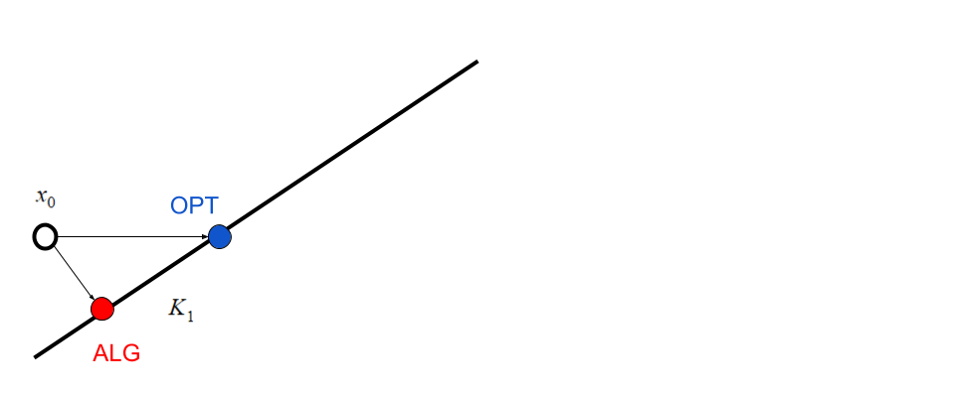
Example

Slide 4
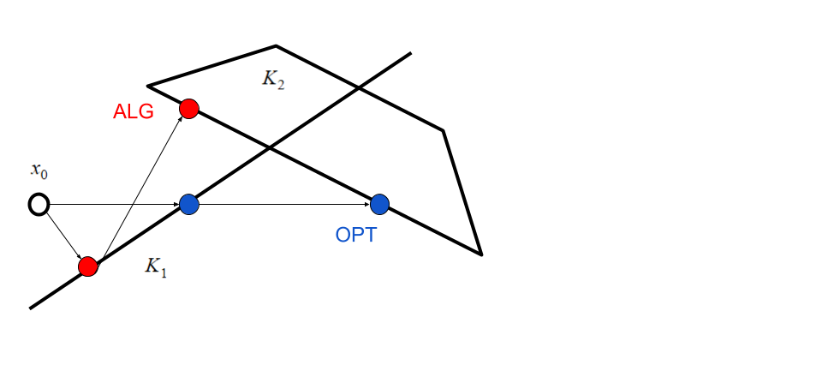
Example

Slide 5
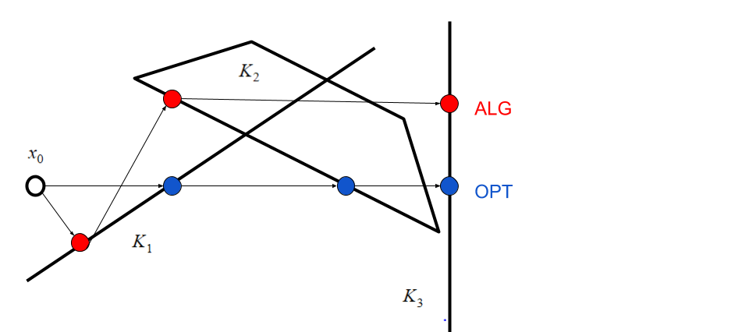
Example

Slide 6
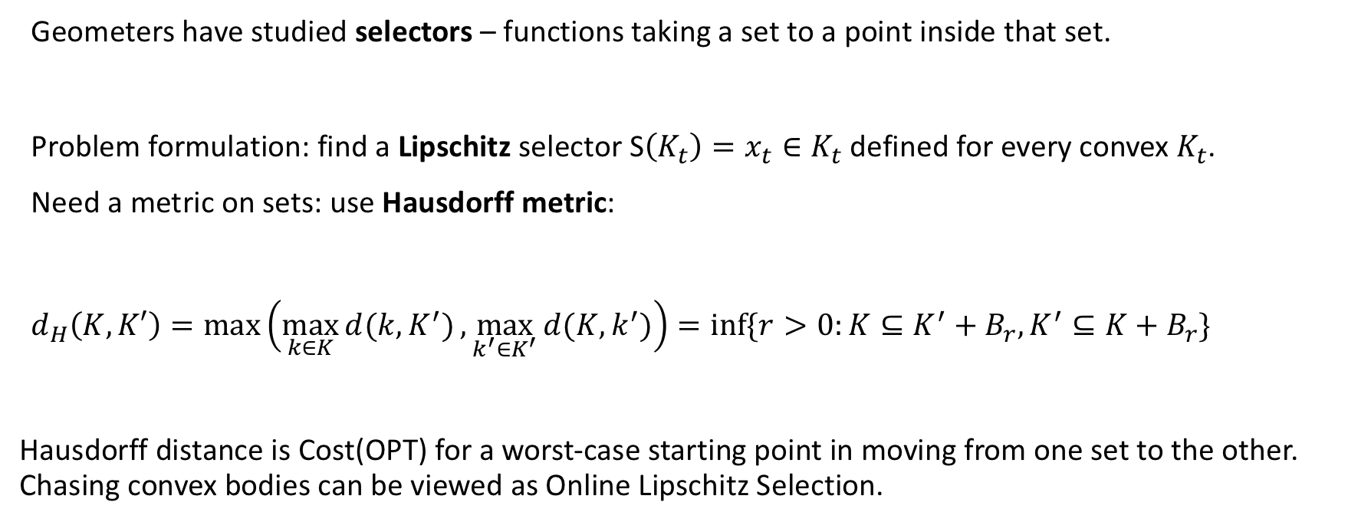
Motivation 1: Online Lipschitz Selection
Geometers have studied selectors – functions taking a set to a point inside that set.
Problem formulation: find a Lipschitz selector S$\left(K_{t}\right)=x_{t}∈K_{t}$ defined for every convex $K_{t}$.
Need a metric on sets: use Hausdorff metric:
$d_{H}\left(K,K′\right)=max\left(\max_{k∈K}{d(k,K^{′})},\max_{k^{′}∈K^{′}}{d(K,k^{′})}\right){=\inf{\{r>0:K⊆K^{′}+B_{r},K^{′}⊆K+B_{r}\}}}$
Hausdorff distance is Cost(OPT) for a worst-case starting point in moving from one set to the other. Chasing convex bodies can be viewed as Online Lipschitz Selection.

Slide 7
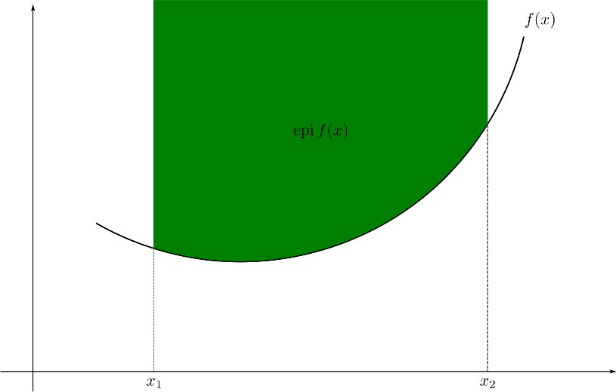
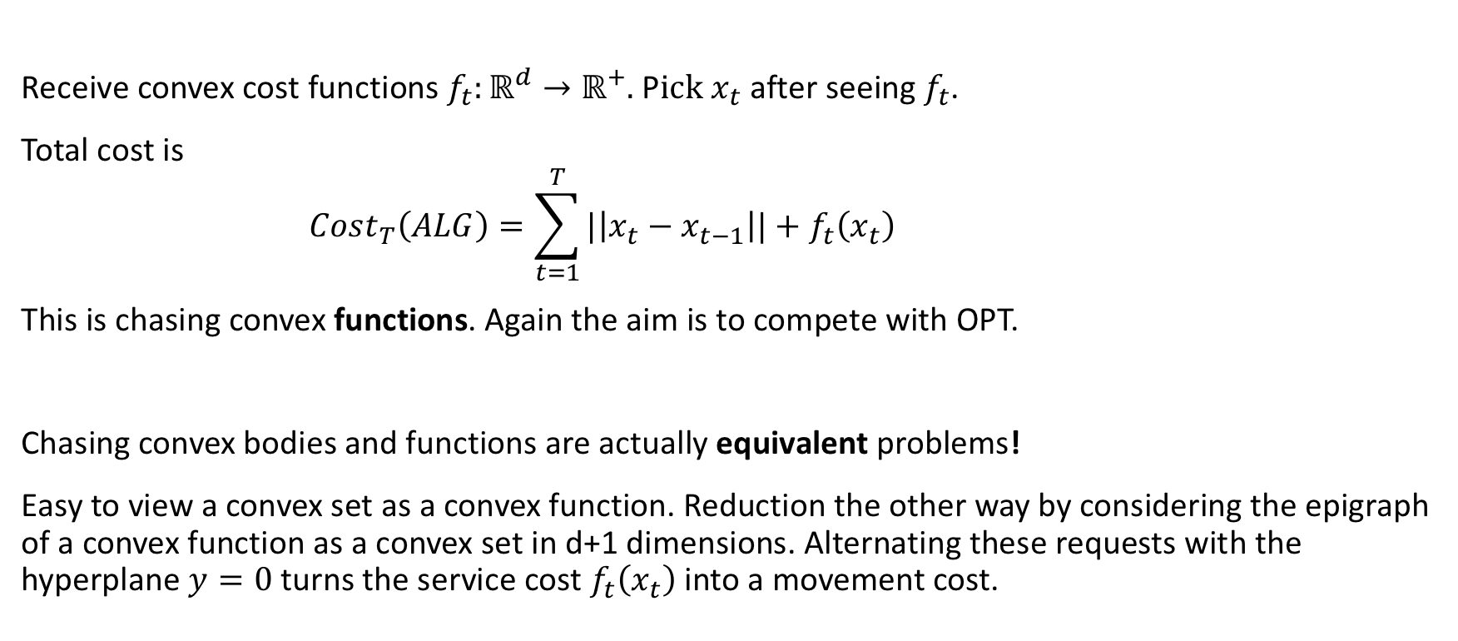
Equivalence to Chasing Convex Functions
Receive convex cost functions $f_{t}:ℝ^{d}→ℝ^{+}.$ P$ick x_{t}$ after seeing $f_{t}$.
Total cost is
$$Cost_{T}\left(ALG\right)=\sum_{t=1}^{T}{|\left|x_{t}−x_{t−1}\right||+f_{t}\left(x_{t}\right) }$$
This is chasing convex functions. Again the aim is to compete with OPT.
Chasing convex bodies and functions are actually equivalent problems!
Easy to view a convex set as a convex function. Reduction the other way by considering the epigraph of a convex function as a convex set in d+1 dimensions. Alternating these requests with the hyperplane $y=0$ turns the service cost $f_{t}\left(x_{t}\right)$ into a movement cost.

Slide 8
Motivation 2: Metrical Task Systems
More general problem: metrical task systems (MTS). Same question as chasing convex functions, but on an arbitrary metric space X with an arbitrary set S of permitted positive cost functions.
Question: how does the competitive ratio depend on X and S?
Competitive ratio is in $\left[\frac{log\left(n\right)}{\log\left(\log\left(n\right)\right)},\log^{2}\left(n\right)\right]$ if $\left|X\right|=n$ with no restriction on the cost functions.
Our problem lives in $ℝ^{d}$, an infinite metric space. Will the restriction to convex functions make the competitive ratio finite? A similar phenomenon happens for the famous k-server problem.

Slide 9
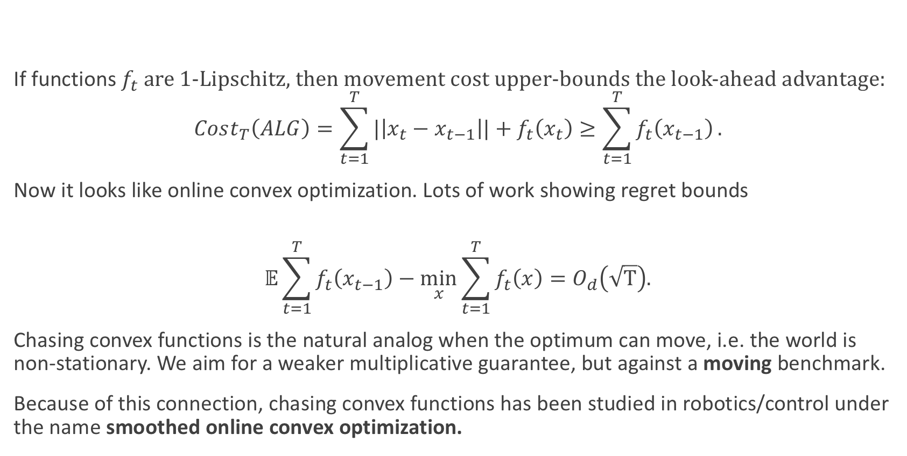
Motivation 3: Online Convex Optimization
If functions $f_{t}$ are 1-Lipschitz, then movement cost upper-bounds the look-ahead advantage:
$$Cost_{T}\left(ALG\right)=\sum_{t=1}^{T}{|\left|x_{t}−x_{t−1}\right||+f_{t}\left(x_{t}\right)}≥\sum_{t=1}^{T}{f_{t}\left(x_{t−1}\right)}.$$
Now it looks like online convex optimization. Lots of work showing regret bounds
$$𝔼\sum_{t=1}^{T}{f_{t}\left(x_{t−1}\right)}−\min_{x}\sum_{t=1}^{T}{f_{t}\left(x\right)=O_{d}\left(\sqrt{T}\right).}$$
Chasing convex functions is the natural analog when the optimum can move, i.e. the world is non-stationary. We aim for a weaker multiplicative guarantee, but against a moving benchmark.
Because of this connection, chasing convex functions has been studied in robotics/control under the name smoothed online convex optimization.

Slide 10
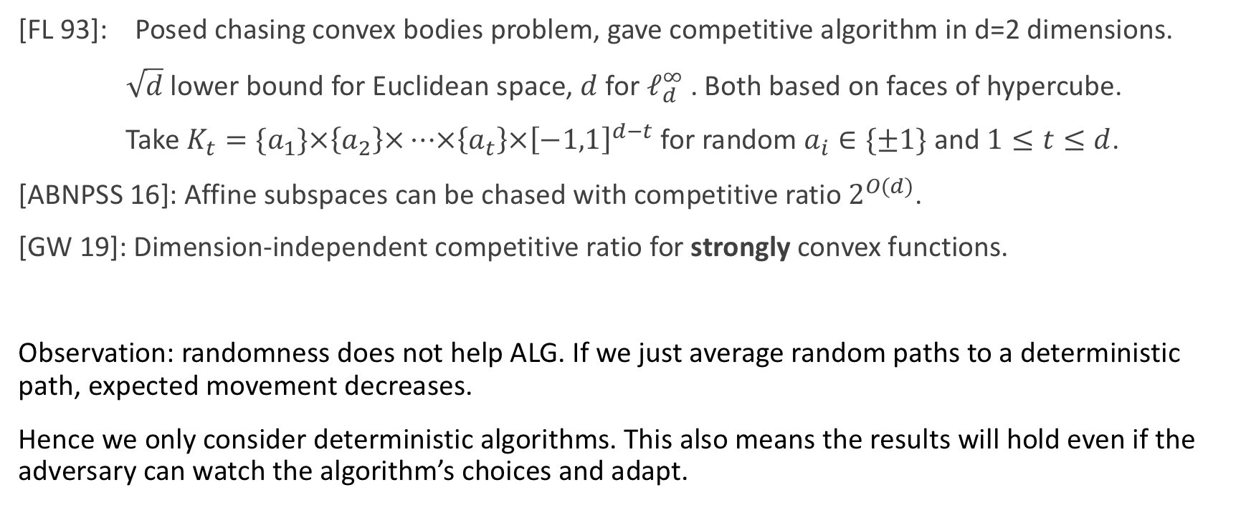
Some Previous Work
[FL 93]: Posed chasing convex bodies problem, gave competitive algorithm in d=2 dimensions.
$\sqrt{d}$lower bound for Euclidean space, $d$ for $ℓ_{d}^{∞}$ . Both based on faces of hypercube.
Take $K_{t}=\{a_{1}\}×\left\{a_{2}\right\}×…×\left\{a_{t}\right\}×{\left[−1,1\right]}^{d−t}$ for random $a_{i}∈\{±1\}$ and $1≤t≤d$.
[ABNPSS 16]: Affine subspaces can be chased with competitive ratio $2^{O(d)}$.
[GW 19]: Dimension-independent competitive ratio for strongly convex functions.
Observation: randomness does not help ALG. If we just average random paths to a deterministic path, expected movement decreases.
Hence we only consider deterministic algorithms. This also means the results will hold even if the adversary can watch the algorithm’s choices and adapt.

Slide 11
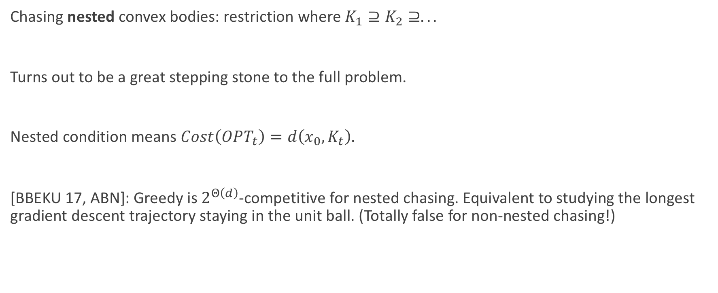
Chasing Nested Convex Bodies
Chasing nested convex bodies: restriction where $K_{1}⊇K_{2}⊇.. .$
Turns out to be a great stepping stone to the full problem.
Nested condition means $Cost\left(OPT_{t}\right)=d\left(x_{0},K_{t}\right).$
[BBEKU 17, ABN]: Greedy is $2^{Θ\left(d\right)}$-competitive for nested chasing. Equivalent to studying the longest gradient descent trajectory staying in the unit ball. (Totally false for non-nested chasing!)

Slide 12
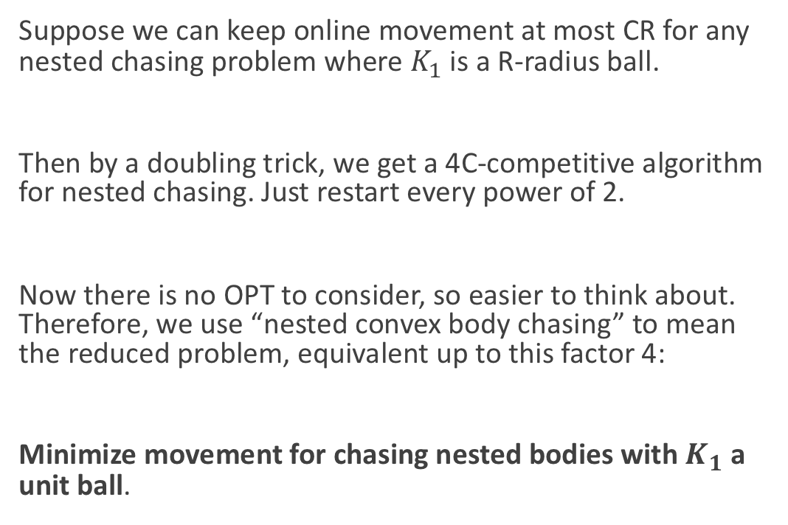
Simpler Formulation of Nested Chasing
Suppose we can keep online movement at most CR for any nested chasing problem where $K_{1}$ is a R-radius ball.
Then by a doubling trick, we get a 4C-competitive algorithm for nested chasing. Just restart every power of 2.
Now there is no OPT to consider, so easier to think about. Therefore, we use “nested convex body chasing” to mean the reduced problem, equivalent up to this factor 4:
Minimize movement for chasing nested bodies with $K_{1}$ a unit ball.

Slide 13
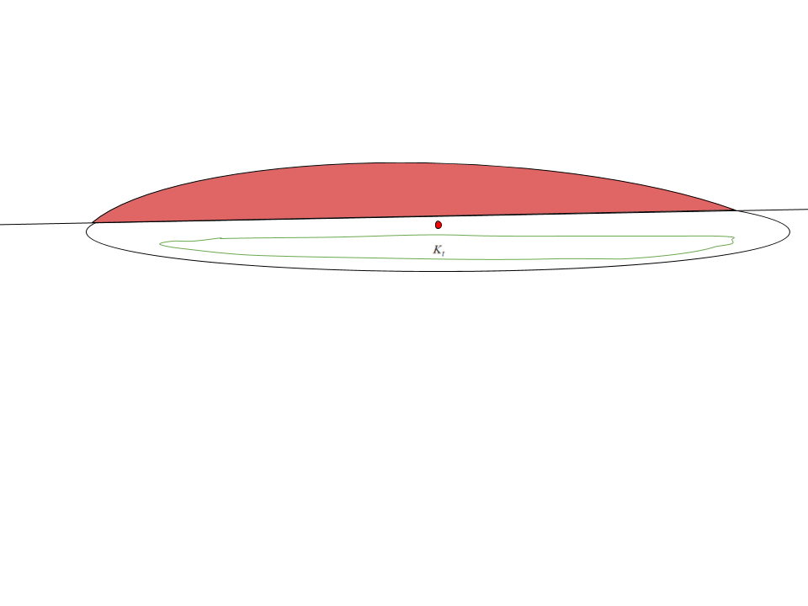
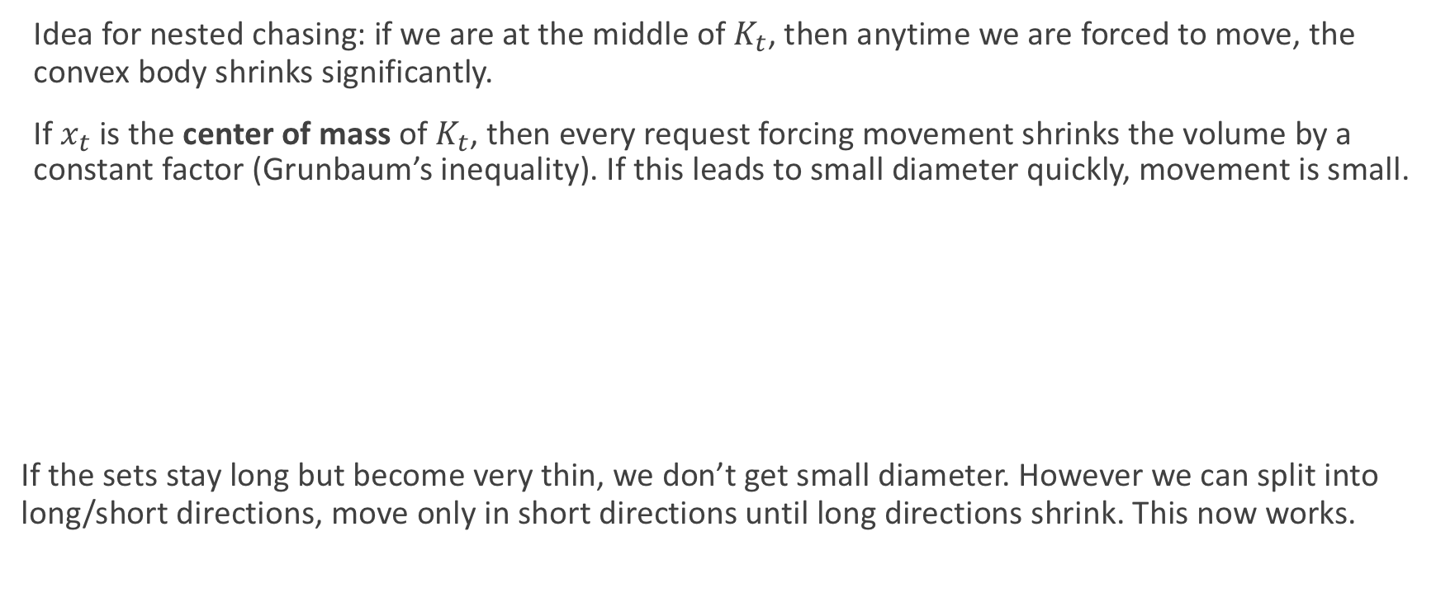
Previously: Recursive Bare-Hands Approach
Idea for nested chasing: if we are at the middle of $K_{t}$, then anytime we are forced to move, the convex body shrinks significantly.
If $x_{t}$ is the center of mass of $K_{t}$, then every request forcing movement shrinks the volume by a constant factor (Grunbaum’s inequality). If this leads to small diameter quickly, movement is small.
If the sets stay long but become very thin, we don’t get small diameter. However we can split into long/short directions, move only in short directions until long directions shrink. This now works.

Slide 14
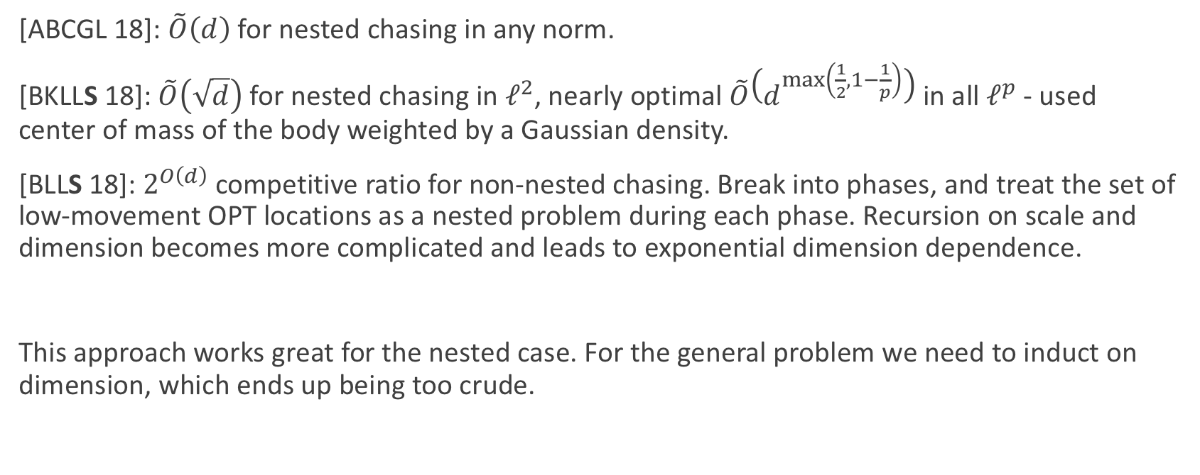
Results From Recursive Bare-Hands
[ABCGL 18]: $\tilde{O}\left(d\right)$ for nested chasing in any norm.
[BKLLS 18]: $\tilde{O}\left(\sqrt{d}\right)$ for nested chasing in $ℓ^{2}$, nearly optimal $\tilde{O}\left(d^{\max\left(\frac{1}{2},1−\frac{1}{p}\right)}\right)$in all $ℓ^{p}$ - used center of mass of the body weighted by a Gaussian density.
[BLLS 18]: $2^{O\left(d\right)}$ competitive ratio for non-nested chasing. Break into phases, and treat the set of low-movement OPT locations as a nested problem during each phase. Recursion on scale and dimension becomes more complicated and leads to exponential dimension dependence.
This approach works great for the nested case. For the general problem we need to induct on dimension, which ends up being too crude.

Slide 15
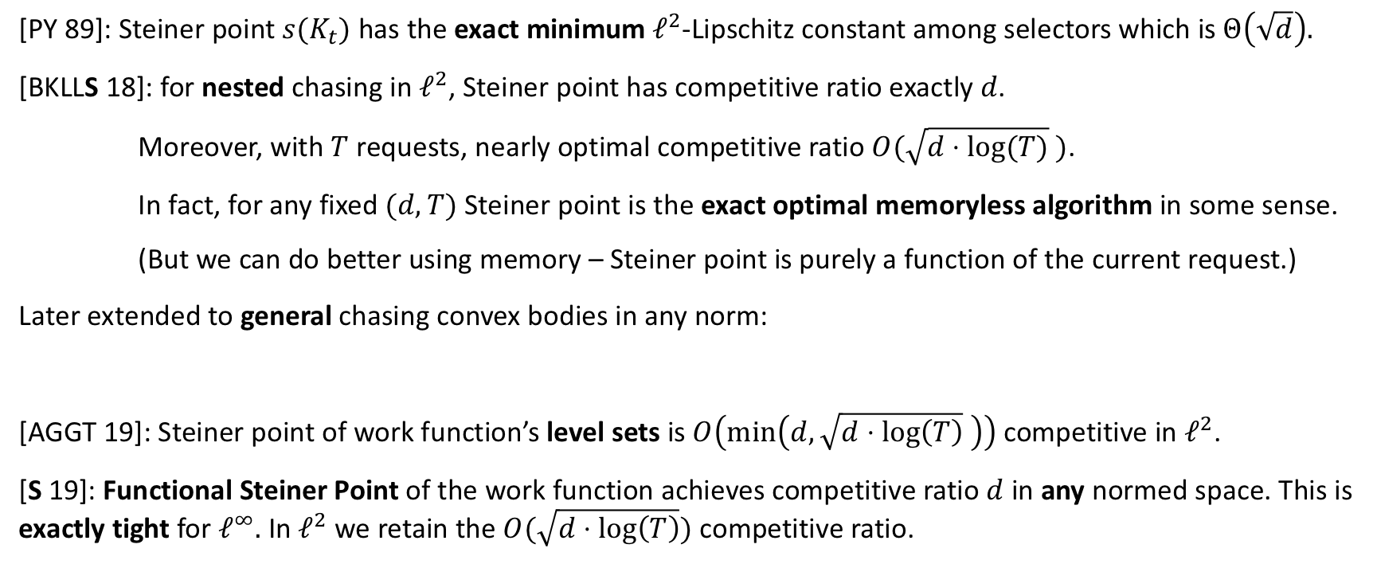
New Approach: Steiner Point
[PY 89]: Steiner point $s(K_{t})$ has the exact minimum $ℓ^{2}$-Lipschitz constant among selectors which is $Θ\left(\sqrt{d}\right).$
[BKLLS 18]: for nested chasing in $ℓ^{2}$, Steiner point has competitive ratio exactly $d$.
Moreover, with $T$ requests, nearly optimal competitive ratio $O(\sqrt{d⋅log⁡(T)} )$.
In fact, for any fixed $(d,T)$ Steiner point is the exact optimal memoryless algorithm in some sense.
(But we can do better using memory – Steiner point is purely a function of the current request.)
Later extended to general chasing convex bodies in any norm:
[AGGT 19]: Steiner point of work function’s level sets is $O\left(\min\left(d,\sqrt{d⋅\log\left(T\right)} \right)\right)$ competitive in $ℓ^{2}$.
[S 19]: Functional Steiner Point of the work function achieves competitive ratio $d$ in any normed space. This is exactly tight for $ℓ^{∞}.$ In $ℓ^{2}$ we retain the $O(\sqrt{d⋅log\left(T\right)})$ competitive ratio.

Slide 16
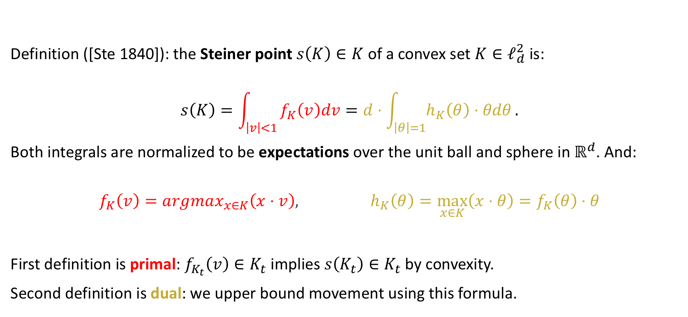
What is the Steiner Point?
Definition ([Ste 1840]): the Steiner point $s\left(K\right)∈K$ of a convex set $K∈ℓ_{d}^{2}$ is:
$$s\left(K\right)=\int_{\left|v\right|<1}{f_{K}\left(v\right)dv=d⋅\int_{\left|θ\right|=1}{h_{K}\left(θ\right)⋅θdθ}}.$$
Both integrals are normalized to be expectations over the unit ball and sphere in $ℝ^{d}$. And:
$$f_{K}\left(v\right)=argmax_{x∈K}\left(x⋅v\right), h_{K}\left(θ\right)=\max_{x∈K}\left(x⋅θ\right)=f_{K}\left(θ\right)⋅θ$$
First definition is primal: $f_{K_{t}}\left(v\right)∈K_{t}$ implies $s\left(K_{t}\right)∈K_{t}$ by convexity.
Second definition is dual: we upper bound movement using this formula.
Support Function
(Scalar)
Extreme Point (Vector)

Slide 17
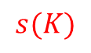
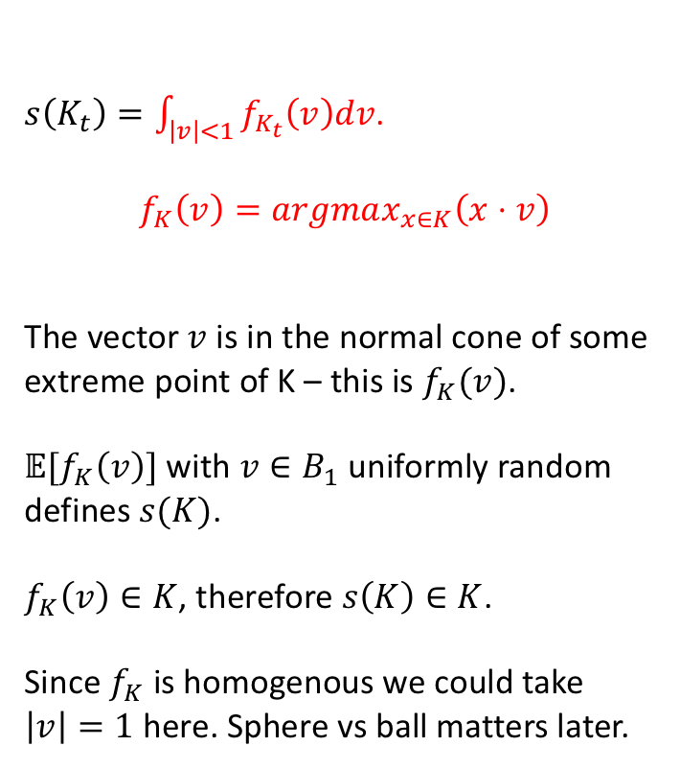
Understanding the Primal Definition
$s\left(K_{t}\right)=\int_{\left|v\right|<1}{f_{K_{t}}\left(v\right)dv}$.
$$f_{K}\left(v\right)=argmax_{x∈K}\left(x⋅v\right)$$
The vector $v$ is in the normal cone of some extreme point of K – this is $f_{K}(v)$.
$𝔼[f_{K}\left(v\right)]$ with $v∈B_{1}$ uniformly random defines $s(K)$.
$f_{K}\left(v\right)∈K$, therefore $s\left(K\right)∈K$.
Since $f_{K}$ is homogenous we could take $\left|v\right|=1$ here. Sphere vs ball matters later.
$$s(K)$$

Slide 18
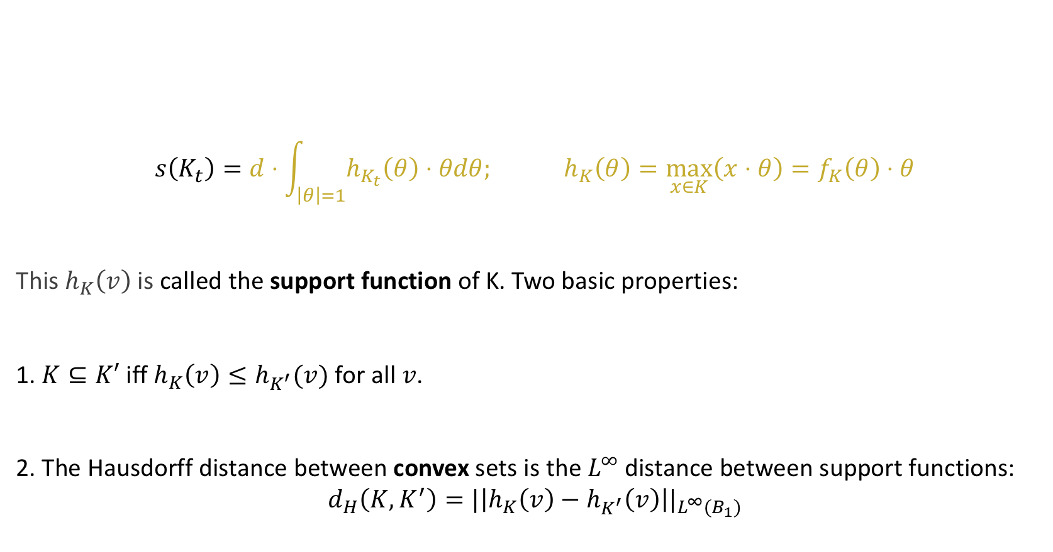
Understanding the Dual Definition
$$s\left(K_{t}\right)=d⋅\int_{\left|θ\right|=1}{h_{K_{t}}\left(θ\right)⋅θdθ; }h_{K}\left(θ\right)=\max_{x∈K}\left(x⋅θ\right)=f_{K}\left(θ\right)⋅θ$$
This $h_{K}\left(v\right)$ is called the support function of K. Two basic properties:
1. $K⊆K′$ iff $h_{K}\left(v\right)≤h_{K^{′}}(v)$ for all $v$.
2. The Hausdorff distance between convex sets is the $L^{∞}$ distance between support functions:
$$d_{H}\left(K,K^{′}\right)=|\left|h_{K}\left(v\right)−h_{K^{′}}\left(v\right)\right||_{L^{∞}(B_{1})}$$

Slide 19
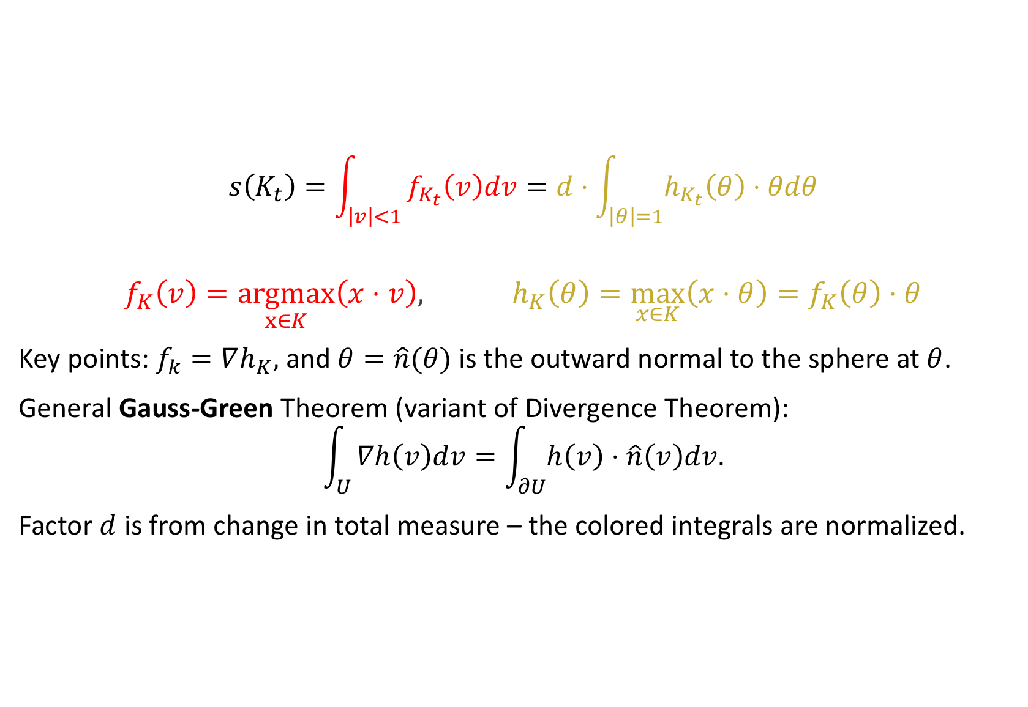
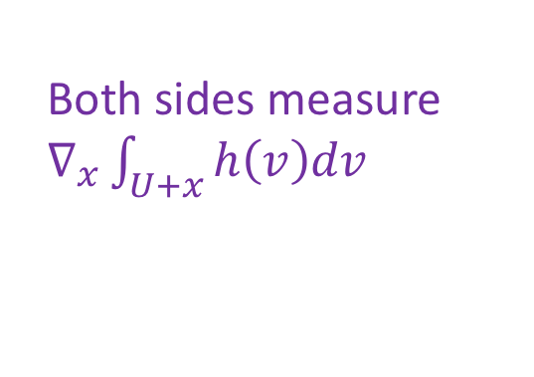
Why Do The Definitions Agree?
$$s\left(K_{t}\right)=\int_{\left|v\right|<1}{f_{K_{t}}\left(v\right)dv=d⋅\int_{\left|θ\right|=1}{h_{K_{t}}\left(θ\right)⋅θdθ}}$$
$$f_{K}\left(v\right)=\underset{x∈K}{argmax}\left(x⋅v\right), h_{K}\left(θ\right)=\max_{x∈K}\left(x⋅θ\right)=f_{K}\left(θ\right)⋅θ$$
Key points: $f_{k}=∇h_{K},$ and $θ=\hat{n}(θ)$ is the outward normal to the sphere at $θ$.
General Gauss-Green Theorem (variant of Divergence Theorem):
$$\int_{U}{∇h\left(v\right)dv=\int_{∂U}{h\left(v\right)⋅\hat{n}\left(v\right)dv.}}$$
Factor $d$ is from change in total measure – the colored integrals are normalized.
Both sides measure $∇_{x}\int_{U+x}{h\left(v\right)dv}$

Slide 20
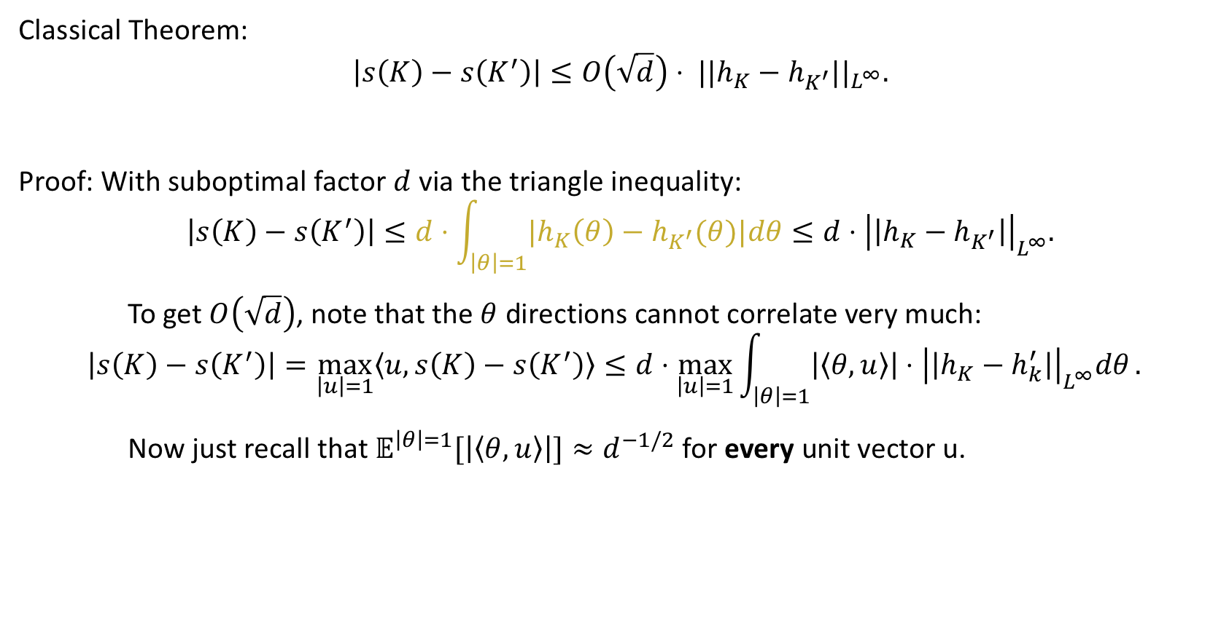
Steiner Point is a Lipschitz Selector
Classical Theorem:
$${\left|s\left(K\right)−s\left(K^{′}\right)\right|≤O\left(\sqrt{d}\right)⋅ ||h_{K}−h_{K^{′}}||}_{L^{∞}}.$$
Proof: With suboptimal factor $d$ via the triangle inequality:
$$\left|s\left(K\right)−s\left(K^{′}\right)\right|≤d⋅\int_{\left|θ\right|=1}{{|h}_{K}\left(θ\right)−h_{K^{′}}(θ)|dθ}≤d⋅{\left|\left|h_{K}−h_{K^{′}}\right|\right|}_{L^{∞}}.$$
To get $O\left(\sqrt{d}\right)$, note that the $θ$ directions cannot correlate very much:
$${\left|s\left(K\right)−s\left(K^{′}\right)\right|=\max_{\left|u\right|=1}{〈u,s\left(K\right)−s\left(K^{′}\right)〉}≤d⋅{\max_{\left|u\right|=1}{\int_{\left|θ\right|=1}{\left|〈θ,u〉\right|}⋅{\left|\left|h_{K}−h_{k}^{′}\right|\right|}_{L^{∞}}^{ }dθ}.}_{ }}_{ }$$
Now just recall that $𝔼^{\left|θ\right|=1}[\left|〈θ,u〉\right|]≈d^{−1/2}$ for every unit vector u.

Slide 21
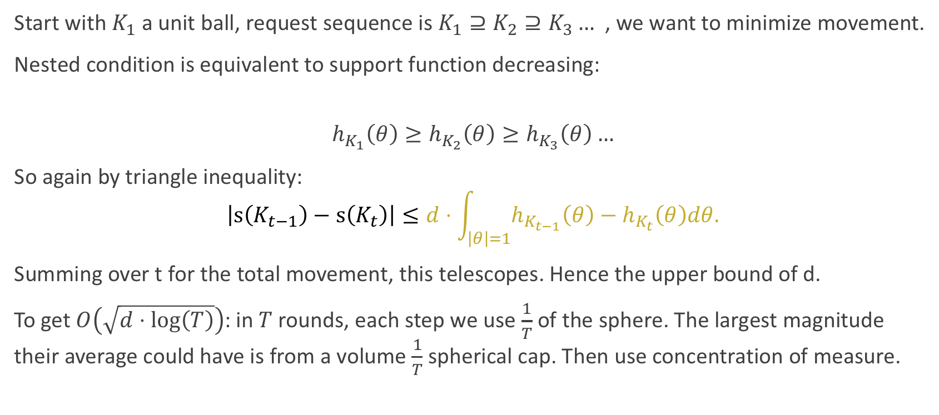
Chasing Nested Bodies with Steiner
Start with $K_{1}$ a unit ball, request sequence is $K_{1}⊇K_{2}⊇K_{3}…$ , we want to minimize movement.
Nested condition is equivalent to support function decreasing:
$$h_{K_{1}}\left(θ\right)≥h_{K_{2}}\left(θ\right)≥h_{K_{3}}\left(θ\right)…$$
So again by triangle inequality:
$$\left|s\left(K_{t−1}\right)−s\left(K_{t}\right)\right|≤d⋅\int_{\left|θ\right|=1}{h_{K_{t−1}}\left(θ\right)−h_{K_{t}}\left(θ\right)dθ.}$$
Summing over t for the total movement, this telescopes. Hence the upper bound of d.
To get $O\left(\sqrt{d⋅\log\left(T\right)}\right)$: in $T$ rounds, each step we use $\frac{1}{T}$ of the sphere. The largest magnitude their average could have is from a volume $\frac{1}{T}$ spherical cap. Then use concentration of measure.

Slide 22
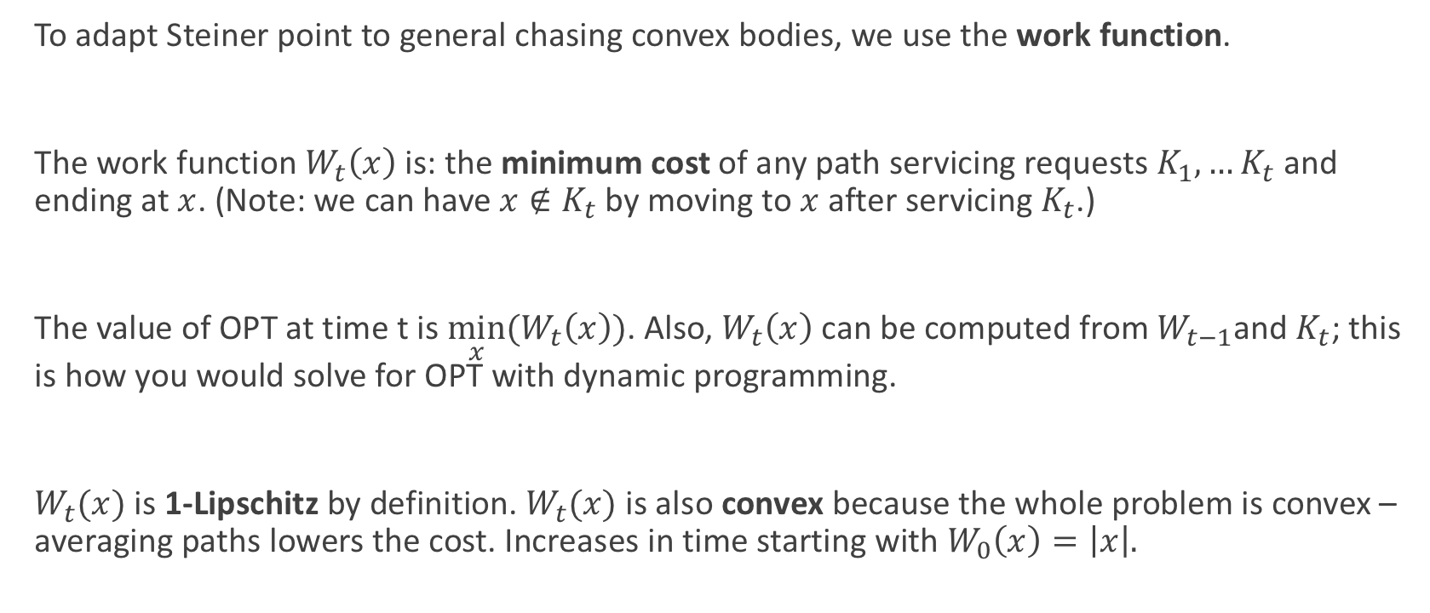
Chasing General Convex Bodies and the Work Function
To adapt Steiner point to general chasing convex bodies, we use the work function.
The work function $W_{t}\left(x\right)$ is: the minimum cost of any path servicing requests $K_{1},…K_{t}$ and ending at $x$. (Note: we can have $x∉K_{t}$ by moving to $x$ after servicing $K_{t}$.)
The value of OPT at time t is $\min_{x}(W_{t}\left(x\right))$. Also, $W_{t}\left(x\right)$ can be computed from$W_{t−1}$and $K_{t}$; this is how you would solve for OPT with dynamic programming.
$W_{t}(x)$ is 1-Lipschitz by definition. $W_{t}(x)$ is also convex because the whole problem is convex – averaging paths lowers the cost. Increases in time starting with $W_{0}\left(x\right)=\left|x\right|.$

Slide 23
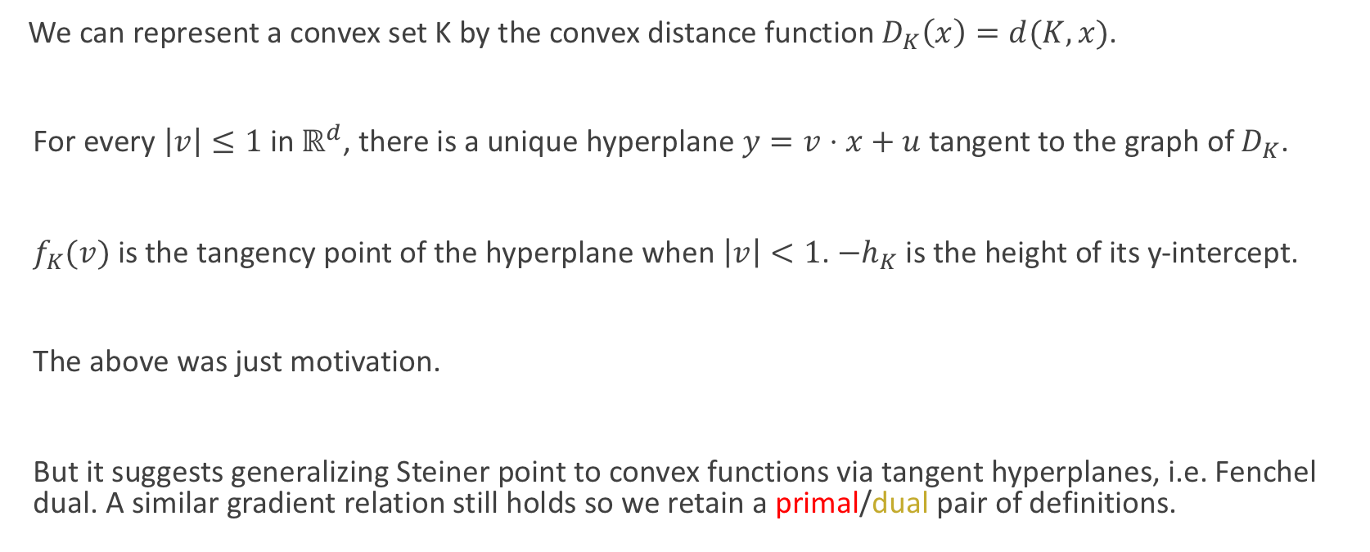
The Steiner Point of a Convex Function
We can represent a convex set K by the convex distance function $D_{K}\left(x\right)=d(K,x)$.
For every $\left|v\right|≤1$ in $ℝ^{d}$, there is a unique hyperplane $y=v⋅x+u$ tangent to the graph of $D_{K}$.
$f_{K}(v)$ is the tangency point of the hyperplane when $\left|v\right|<1$. ${−h}_{K}$ is the height of its y-intercept.
The above was just motivation.
But it suggests generalizing Steiner point to convex functions via tangent hyperplanes, i.e. Fenchel dual. A similar gradient relation still holds so we retain a primal/dual pair of definitions.

Slide 24
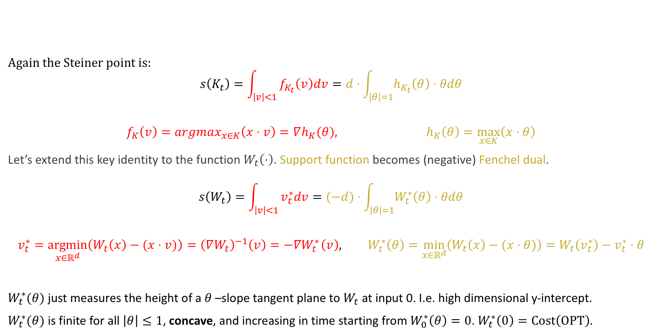
Defining the Functional Steiner Point
Again the Steiner point is:
$$s\left(K_{t}\right)=\int_{\left|v\right|<1}{f_{K_{t}}\left(v\right)dv=d⋅\int_{\left|θ\right|=1}{h_{K_{t}}\left(θ\right)⋅θdθ}}$$
$$f_{K}\left(v\right)=argmax_{x∈K}\left(x⋅v\right)=∇h_{K}(θ), h_{K}\left(θ\right)=\max_{x∈K}\left(x⋅θ\right)$$
Let’s extend this key identity to the function $W_{t}\left(⋅\right)$. Support function becomes (negative) Fenchel dual.
$$s\left(W_{t}\right)=\int_{\left|v\right|<1}{v_{t}^{∗}dv=(−d)⋅\int_{\left|θ\right|=1}{W_{t}^{∗}\left(θ\right)⋅θdθ}}$$
$$v_{t}^{∗}=\underset{x∈ℝ^{d}}{argmin}\left(W_{t}\left(x\right)−(x⋅v)\right){ ={\left(∇W_{t}\right)}^{−1}\left(v\right)=−∇W}_{t}^{∗}\left(v\right), W_{t}^{∗}\left(θ\right)=\min_{x∈ℝ^{d}}\left(W_{t}\left(x\right)−(x⋅θ)\right)=W_{t}\left(v_{t}^{∗}\right)−v_{t}^{∗}⋅θ$$
$W_{t}^{∗}(θ)$ just measures the height of a $θ$–slope tangent plane to $W_{t}$ at input 0. I.e. high dimensional y-intercept.
$W_{t}^{∗}(θ)$ is finite for all $\left|θ\right|≤1$, concave, and increasing in time starting from $W_{0}^{∗}\left(θ\right)=0$. $W_{t}^{∗}\left(0\right)=Cost\left(OPT\right).$

Slide 25
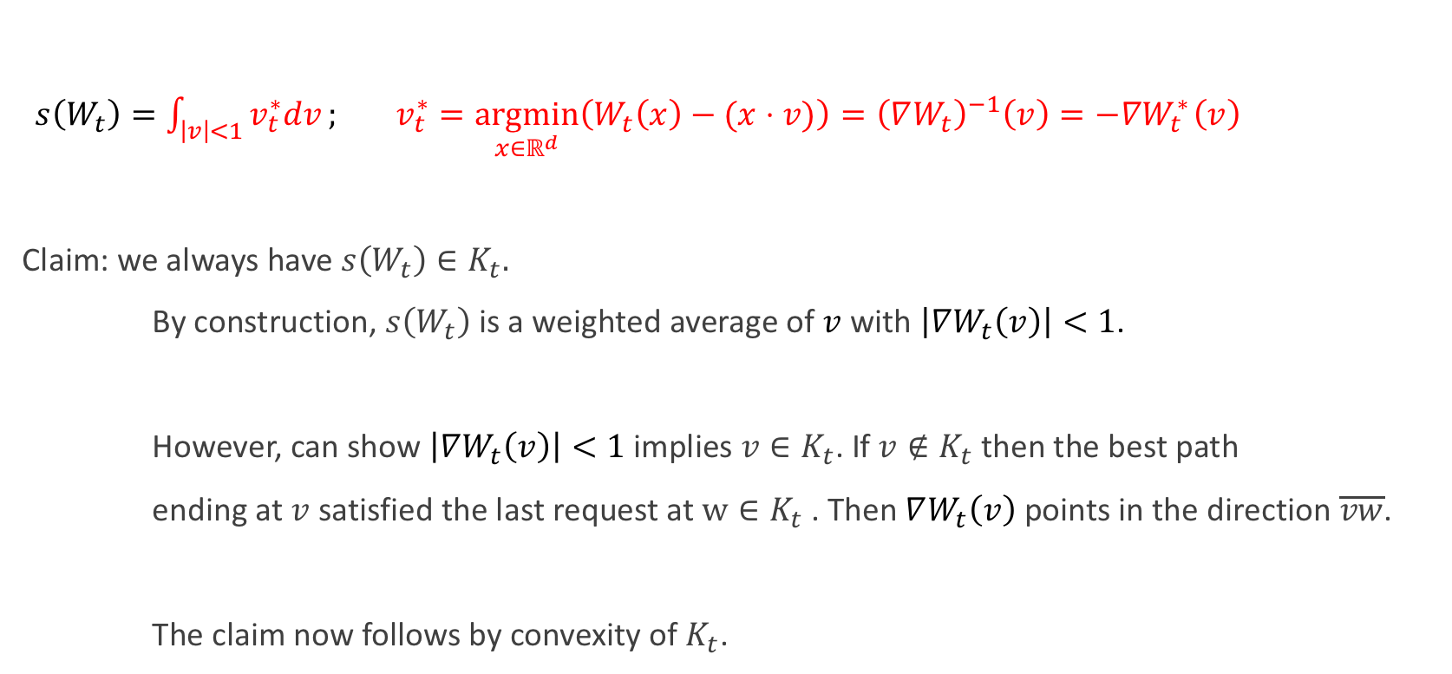
Functional Steiner Point is an Online Selector
$s\left(W_{t}\right)=\int_{\left|v\right|<1}{v_{t}^{∗}dv}; v_{t}^{∗}=\underset{x∈ℝ^{d}}{argmin}\left(W_{t}\left(x\right)−(x⋅v)\right){ ={\left(∇W_{t}\right)}^{−1}\left(v\right)=−∇W}_{t}^{∗}\left(v\right)$
Claim: we always have $s\left(W_{t}\right)∈K_{t}.$
By construction, $s\left(W_{t}\right)$ is a weighted average of $v$ with $\left|∇W_{t}\left(v\right)\right|<1$.
However, can show $\left|∇W_{t}\left(v\right)\right|<1$ implies $v∈K_{t}$. If $v∉K_{t}$ then the best path
ending at $v$ satisfied the last request at $w∈K_{t}$ . Then $∇W_{t}\left(v\right)$ points in the direction $\overline{vw}$.
The claim now follows by convexity of $K_{t}$.

Slide 26
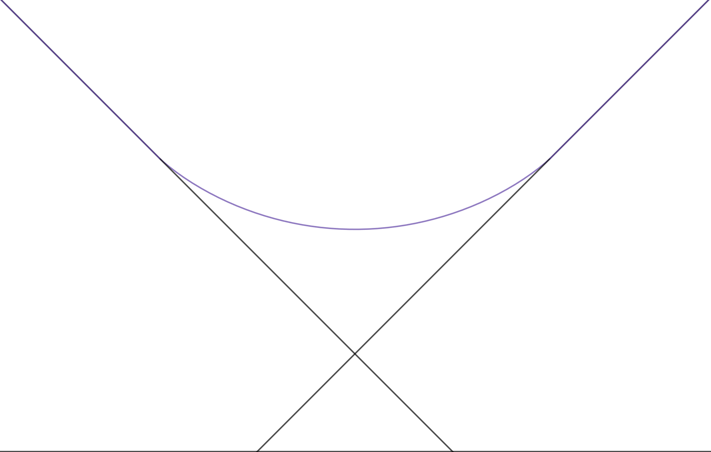
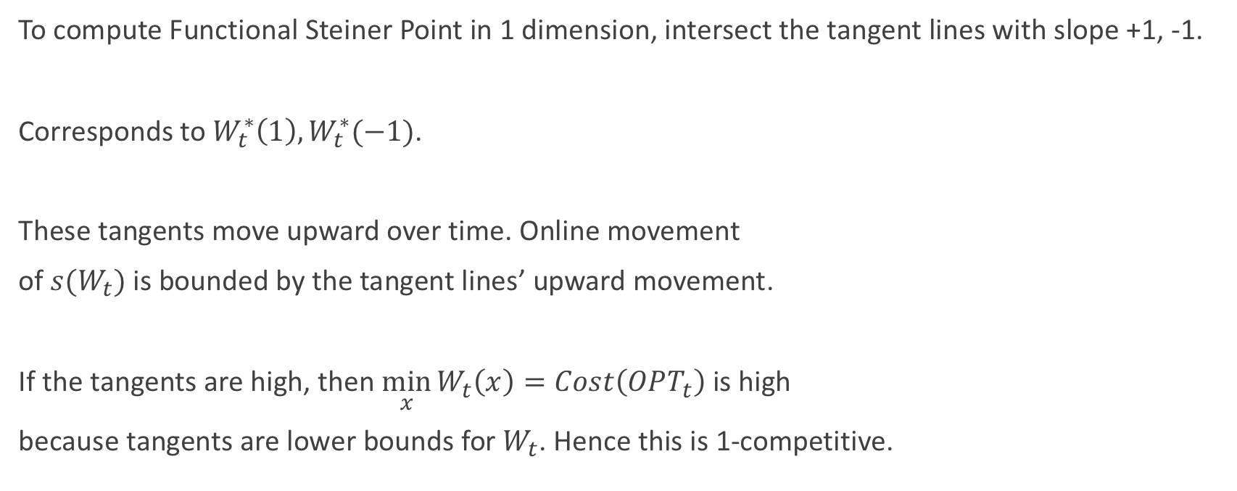
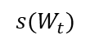
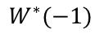
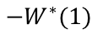
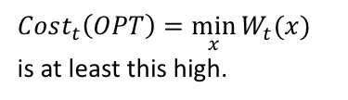
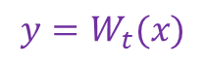
1-Competitiveness in 1 Dimension
To compute Functional Steiner Point in 1 dimension, intersect the tangent lines with slope +1, -1.
Corresponds to $W_{t}^{∗}\left(1\right),W_{t}^{∗}(−1)$.
These tangents move upward over time. Online movement
of $s(W_{t})$ is bounded by the tangent lines’ upward movement.
If the tangents are high, then $\min_{x}{W_{t}\left(x\right)=Cost\left(OPT_{t}\right) }$is high
because tangents are lower bounds for $W_{t}$. Hence this is 1-competitive.
$${y=W}_{t}(x)$$
$Cost_{t}\left(OPT\right)=\min_{x}{W_{t}(x)}$
is at least this high.
$$−W^{∗}(1)$$
$$s(W_{t})$$
$$W^{∗}(−1)$$

Slide 27
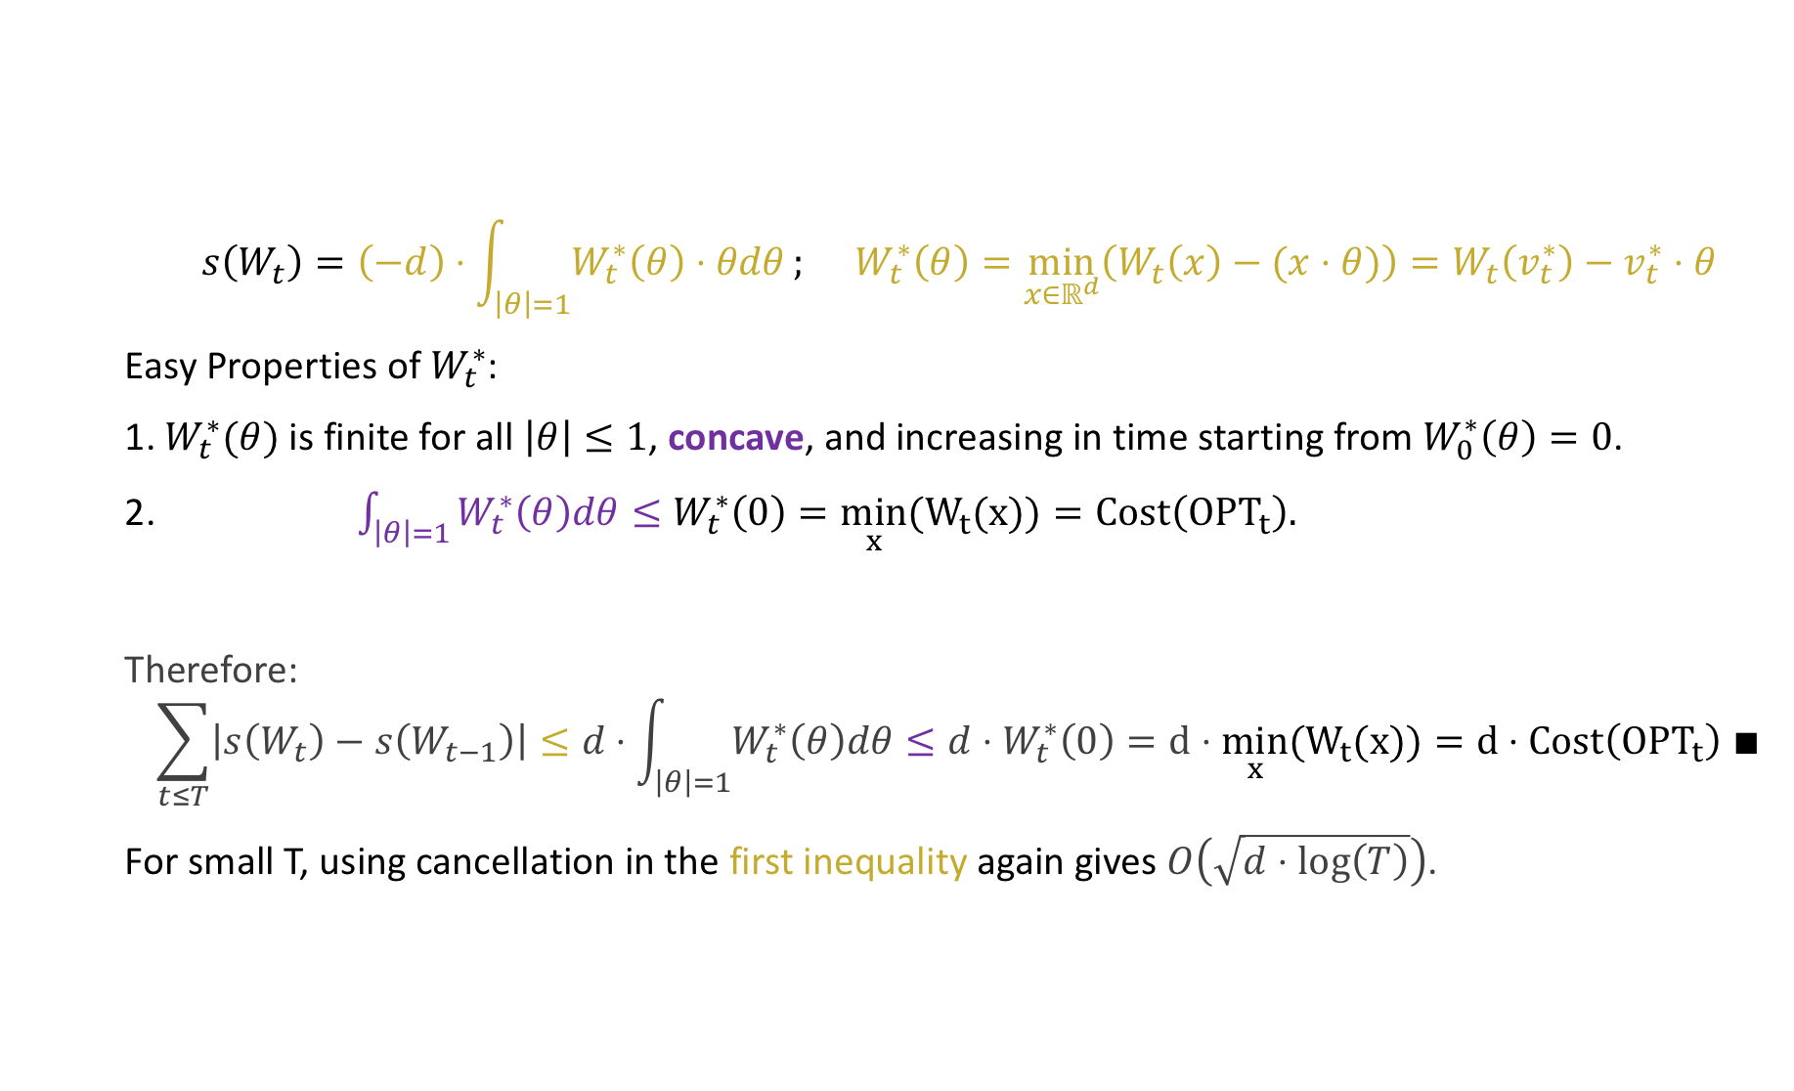

Functional Steiner Point is $d$-Competitive
$$s\left(W_{t}\right)=\left(−d\right)⋅\int_{\left|θ\right|=1}{W_{t}^{∗}\left(θ\right)⋅θdθ}; W_{t}^{∗}\left(θ\right)=\min_{x∈ℝ^{d}}\left(W_{t}\left(x\right)−(x⋅θ)\right)=W_{t}\left(v_{t}^{∗}\right)−v_{t}^{∗}⋅θ$$
Easy Properties of $W_{t}^{∗}$:
1. $W_{t}^{∗}(θ)$ is finite for all $\left|θ\right|≤1$, concave, and increasing in time starting from $W_{0}^{∗}\left(θ\right)=0$.
2. ${\int_{\left|θ\right|=1}{W_{t}^{∗}\left(θ\right)dθ}≤W}_{t}^{∗}\left(0\right)=\min_{x}{(W}_{t}(x))=Cost\left({OPT}_{t}\right).$
Therefore:
$$\sum_{t≤T}{\left|s\left(W_{t}\right)−s\left(W_{t−1}\right)\right|≤d⋅\int_{\left|θ\right|=1}{W_{t}^{∗}\left(θ\right)dθ}}≤d⋅W_{t}^{∗}\left(0\right)=d⋅\min_{x}{(W}_{t}(x))=d⋅Cost\left({OPT}_{t}\right) ∎$$
For small T, using cancellation in the first inequality again gives $O\left(\sqrt{d⋅\log\left(T\right)}\right)$.

Slide 28
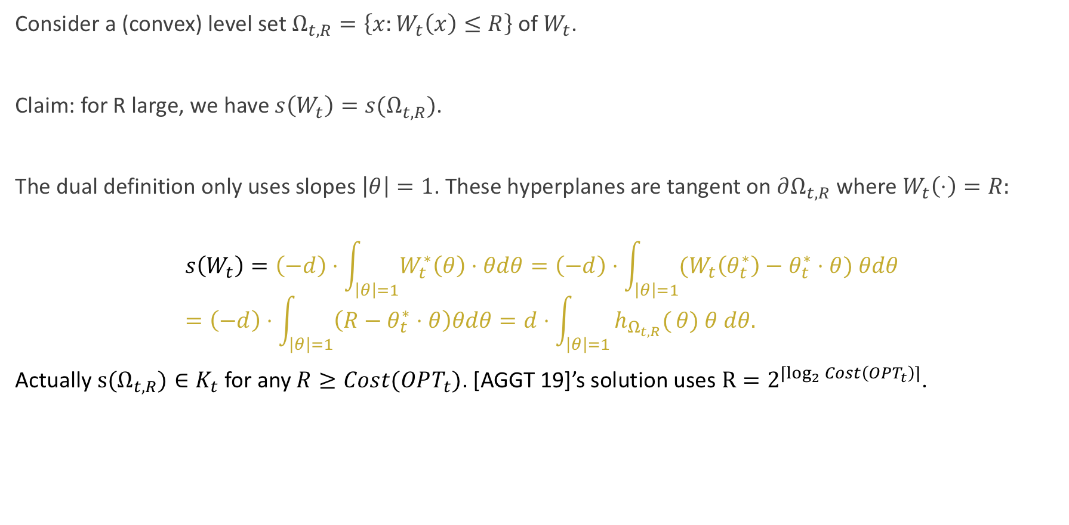
Functional Steiner Point via Level Sets
Consider a (convex) level set $Ω_{t,R}=\left\{x:W_{t}\left(x\right)≤R\right\}$ of $W_{t}$.
Claim: for R large, we have $s\left(W_{t}\right)=s(Ω_{t,R})$.
The dual definition only uses slopes $\left|θ\right|=1$. These hyperplanes are tangent on $∂Ω_{t,R}$ where $W_{t}\left(⋅\right)=R:$
$$s\left(W_{t}\right)=\left(−d\right)⋅\int_{\left|θ\right|=1}{W_{t}^{∗}\left(θ\right)⋅θdθ}=\left(−d\right)⋅\int_{\left|θ\right|=1}{{(W}_{t}\left(θ_{t}^{∗}\right)−θ_{t}^{∗}⋅θ) θdθ}=\left(−d\right)⋅\int_{\left|θ\right|=1}{\left(R−θ_{t}^{∗}⋅θ\right)θdθ=d⋅\int_{\left|θ\right|=1}{h_{Ω_{t,R}}(}θ) θ dθ.}$$
Actually ${s(Ω}_{t,R})∈K_{t}$ for any $R≥Cost(OPT_{t})$. [AGGT 19]’s solution uses $R=2^{⌈\log_{2}{Cost\left(OPT_{t}\right)}⌉}$.

Slide 29
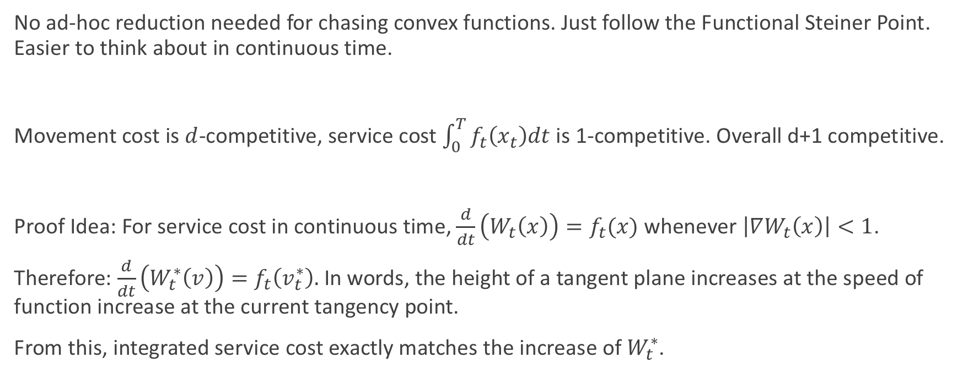
Chasing Convex Functions Directly
No ad-hoc reduction needed for chasing convex functions. Just follow the Functional Steiner Point. Easier to think about in continuous time.
Movement cost is $d$-competitive, service cost $\int_{0}^{T}{f_{t}\left(x_{t}\right)dt}$ is 1-competitive. Overall d+1 competitive.
Proof Idea: For service cost in continuous time, $\frac{d}{dt}\left(W_{t}\left(x\right)\right)=f_{t}(x)$ whenever $\left|∇W_{t}\left(x\right)\right|<1$.
Therefore: $\frac{d}{dt}\left(W_{t}^{∗}\left(v\right)\right)=f_{t}\left(v_{t}^{∗}\right).$ In words, the height of a tangent plane increases at the speed of function increase at the current tangency point.
From this, integrated service cost exactly matches the increase of $W_{t}^{∗}$.

Slide 30
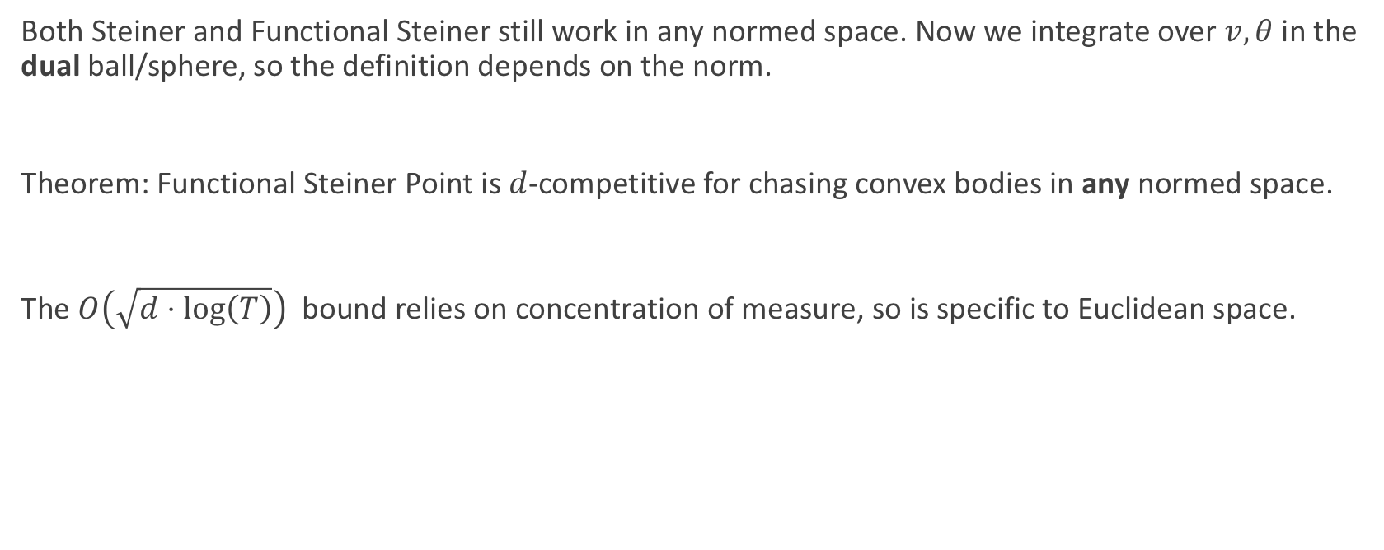
Other Norms
Both Steiner and Functional Steiner still work in any normed space. Now we integrate over $v,θ$ in the dual ball/sphere, so the definition depends on the norm.
Theorem: Functional Steiner Point is $d$-competitive for chasing convex bodies in any normed space.
The $O\left(\sqrt{d⋅\log\left(T\right)}\right)$ bound relies on concentration of measure, so is specific to Euclidean space.

Slide 31
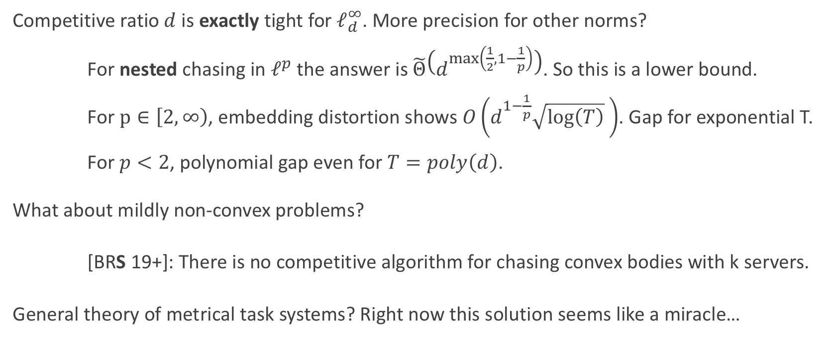
Open Questions
Competitive ratio $d$ is exactly tight for $ℓ_{d}^{∞}$. More precision for other norms?
For nested chasing in $ℓ^{p}$ the answer is $\tilde{Θ}\left(d^{\max\left(\frac{1}{2},1−\frac{1}{p}\right)}\right)$. So this is a lower bound.
For $p∈\left[2,∞\right)$, embedding distortion shows $O\left(d^{1−\frac{1}{p}}\sqrt{\log\left(T\right)} \right)$. Gap for exponential T.
For $p<2$, polynomial gap even for $T=poly\left(d\right)$.
What about mildly non-convex problems?
[BRS 19+]: There is no competitive algorithm for chasing convex bodies with k servers.
General theory of metrical task systems? Right now this solution seems like a miracle…

Slide 32
References
[ABNPSS 16] Antonios Antoniadis, Neal Barcelo, Michael Hugent, Kirk Pruhs, Kevin Schewior, Michele Scquizzato. Chasing convex bodies and functions. LATIN 2016.
[ABCGL 18] C.J. Argue, Sebastien Bubeck, Michael B. Cohen, Anupam Gupta, and Yin Tat Lee. A nearly-linear bound for chasing nested convex bodies. SODA 2019.
[AGGT 19] C.J. Argue, Anupam Gupta, Guru Guruganesh, Ziye Tang. Chasing convex bodies with linear competitive ratio. SODA 2020.
[CGW 18] Niangjun Chen, Gautam Goel, Adam Wierman. Smoothed Online Convex Optimization in High Dimensions via Online Balanced Descent. 2018
[BBEKU 18] Nikhil Bansal, Martin Bohm, Marek Elias, Grigorios Koumoutsos, Seeun William Umboh. Nested convex bodies are chaseable. SODA, 2018.
[BKLLS 18] Sebastien Bubeck, Bo’az Klartag, Yin Tat Lee, Yuanzhi Li, Mark Sellke. Chasing nested convex bodies nearly optimally. SODA 2020.
[BLLS 18] Sebastien Bubeck, Yin Tat Lee, Yuanzhi Li, Mark Sellke. Competitively chasing convex bodies. STOC 2019.
[FL 93] Joel Friedman, Nat Linial. On convex body chasing. Discrete & Computational Geometry 1993.
[GW 19] Gautam Goel, Adam Wierman. An online algorithm for smoothed regression and LQG control. PMLR 2019.
[PY 89] Krzysztof Przesławski and David Yost. Continuity properties of selectors and Michael's theorem. Michigan Mathematics Journal 1989.
[Sch 71] Rolf Schneider. On Steiner points of convex bodies. Israel J Math 1971.
[S 19] Mark Sellke. Chasing convex bodies optimally. SODA 2020.
[Ste 1840] Jakob Steiner. Von dem krümmungs-schwerpuncte ebener curven. 1840.

Slide 33
Thank you!

Slide 34
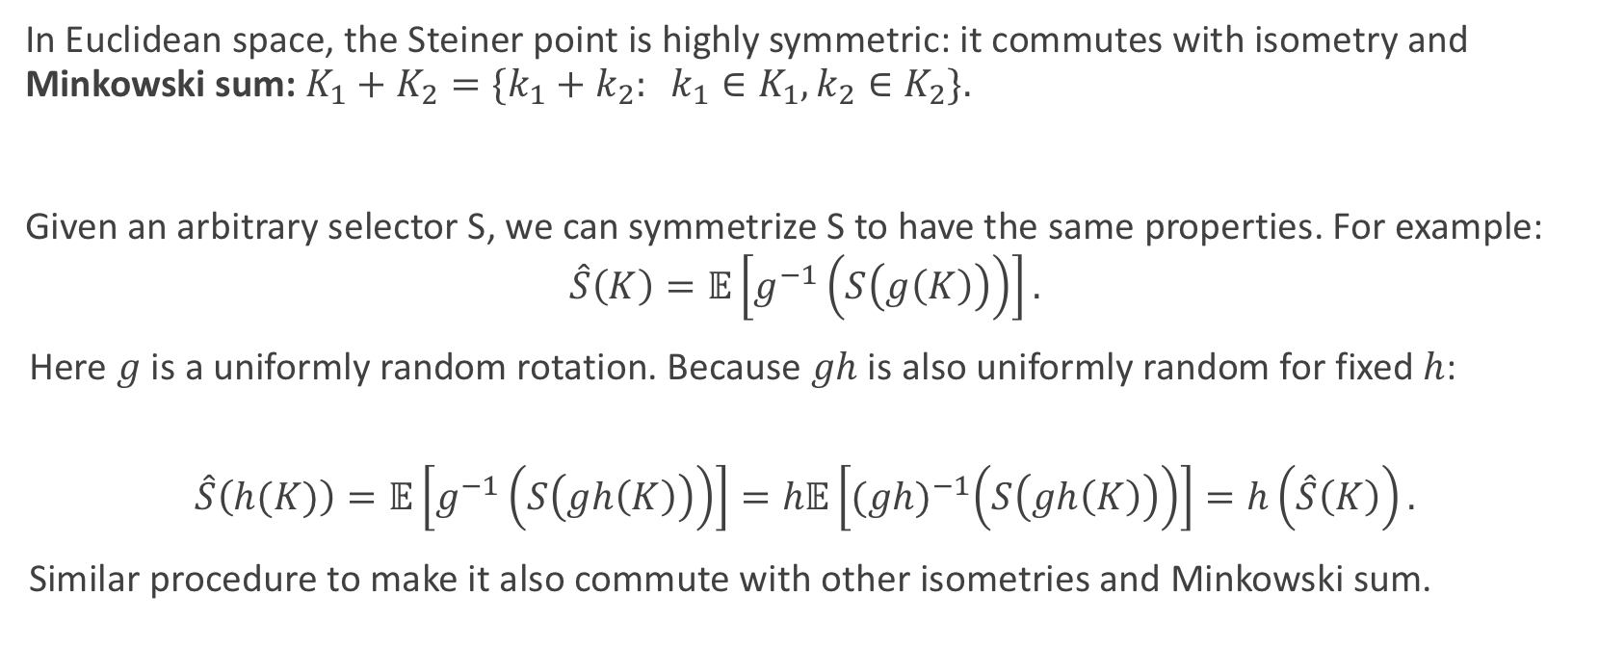
Bonus: Steiner Point Minimizes Euclidean Lipschitz Constant Among Selectors
In Euclidean space, the Steiner point is highly symmetric: it commutes with isometry and Minkowski sum: $K_{1}+K_{2}=\{k_{1}+k_{2}: k_{1}∈K_{1},k_{2}∈K_{2}\}.$
Given an arbitrary selector S, we can symmetrize S to have the same properties. For example:
$$\hat{S}\left(K\right)=𝔼\left[g^{−1}\left(S\left(g\left(K\right)\right)\right)\right].$$
Here $g$ is a uniformly random rotation. Because $gh$ is also uniformly random for fixed $h$:
$$\hat{S}\left(h(K)\right)=𝔼\left[g^{−1}\left(S\left(gh\left(K\right)\right)\right)\right]=h𝔼\left[{(gh)}^{−1}\left(S\left(gh\left(K\right)\right)\right)\right]=h\left(\hat{S}\left(K\right)\right).$$
Similar procedure to make it also commute with other isometries and Minkowski sum.

Slide 35
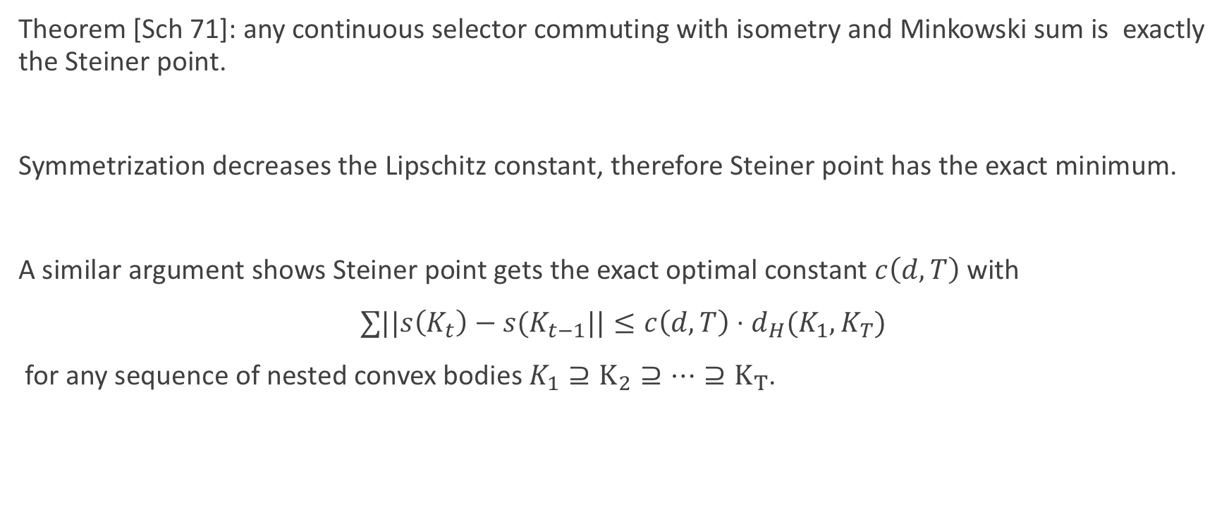
Bonus: Steiner Point Minimizes Euclidean Lipschitz Constant Among Selectors
Theorem [Sch 71]: any continuous selector commuting with isometry and Minkowski sum is exactly the Steiner point.
Symmetrization decreases the Lipschitz constant, therefore Steiner point has the exact minimum.
A similar argument shows Steiner point gets the exact optimal constant $c\left(d,T\right)$ with
$∑||s\left(K_{t}\right)−s(K_{t−1}||≤c\left(d,T\right)⋅d_{H}(K_{1},K_{T})$
for any sequence of nested convex bodies $K_{1}⊇K_{2}⊇…⊇K_{T}$.

Slide 36
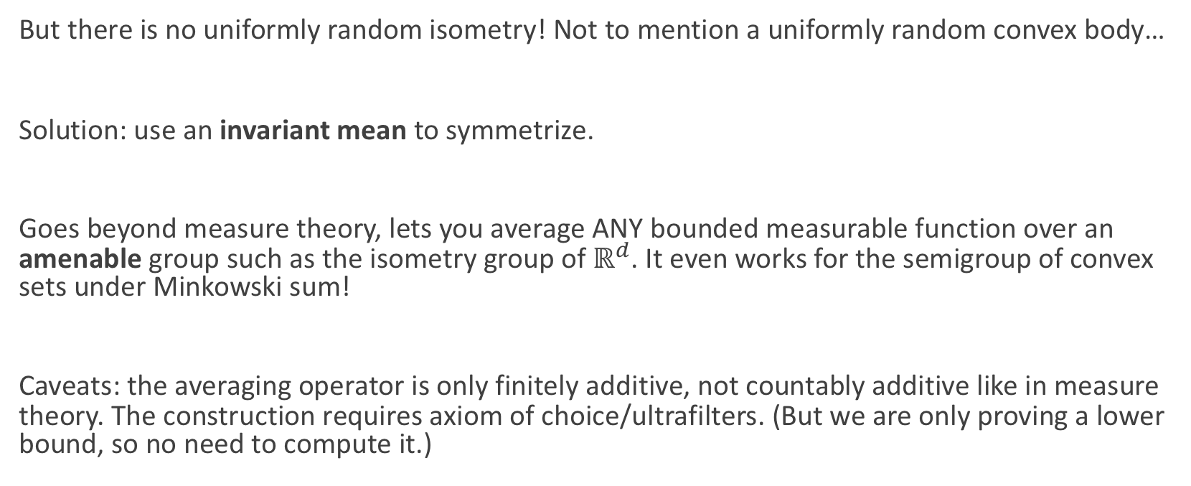
Bonus: Steiner Point Minimizes Euclidean Lipschitz Constant Among Selectors
But there is no uniformly random isometry! Not to mention a uniformly random convex body…
Solution: use an invariant mean to symmetrize.
Goes beyond measure theory, lets you average ANY bounded measurable function over an amenable group such as the isometry group of $ℝ^{d}$. It even works for the semigroup of convex sets under Minkowski sum!
Caveats: the averaging operator is only finitely additive, not countably additive like in measure theory. The construction requires axiom of choice/ultrafilters. (But we are only proving a lower bound, so no need to compute it.)

